Slide 1


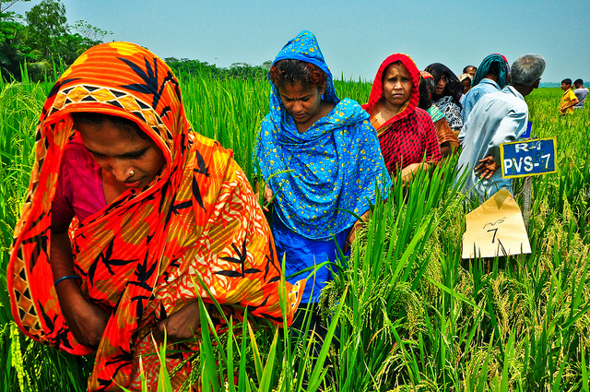
The “tricot” crowdsourcing methodology for varietal diversification
Bioversity International, Information Services and Seed Supplies

Slide 2
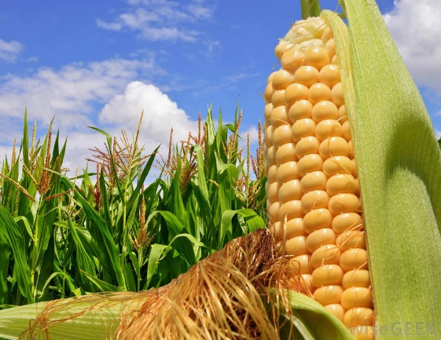
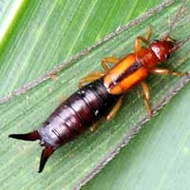

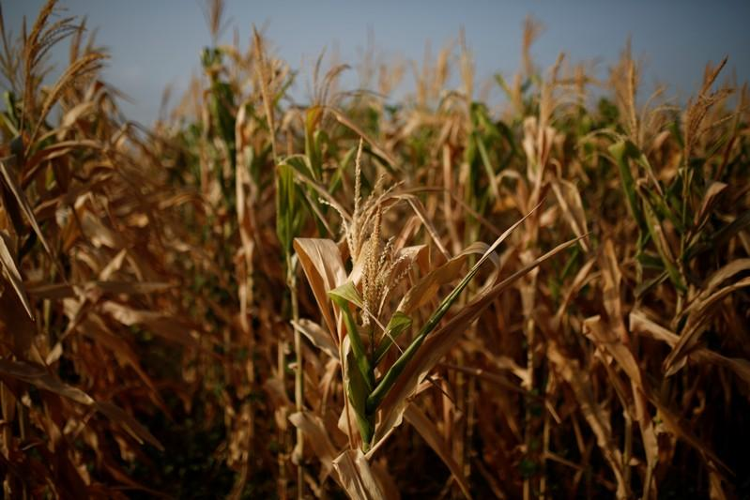
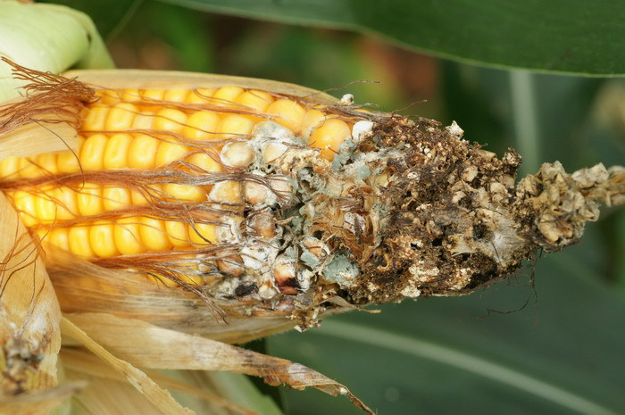
What is the problem we want to solve?
Challinor et al. (2016) Nat. Clim. Change 6:954-958
Tollenar et al. (2017) Nat. Clim. Change 7:275-278
Deutsch et al. (2018) Science 361(6405):916-919
Notes:
Droughts, pests, diseases are among the climate change problems

Slide 3
What is the problem we want to solve?
Climate risk management
Reduce risks by identifying the best technology for each climatic region
Register genotype x environmental interactions and changes in climatic patterns as they occur in the field
Identify a diversified portfolio of technologies to reduce crop losses

Slide 4

But, current methods lacks scalability

Slide 5
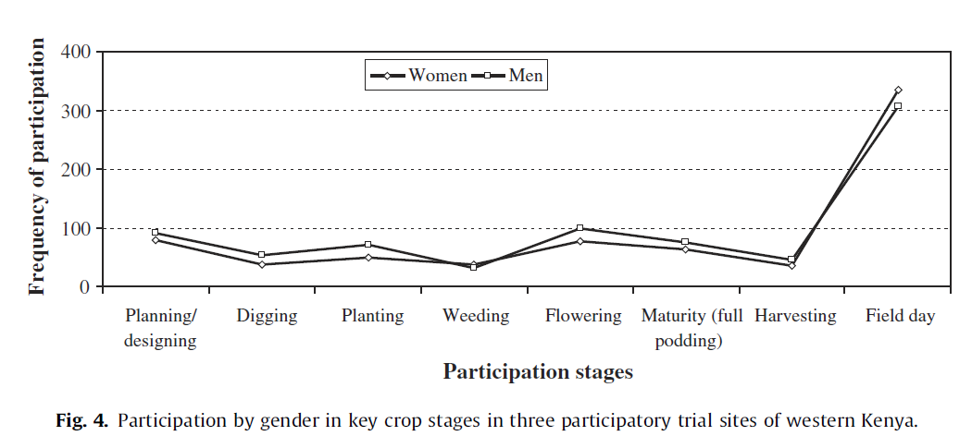
But, current methods lacks scalability
Misiko (2013) Agricultural Systems 119:35-42

Slide 6
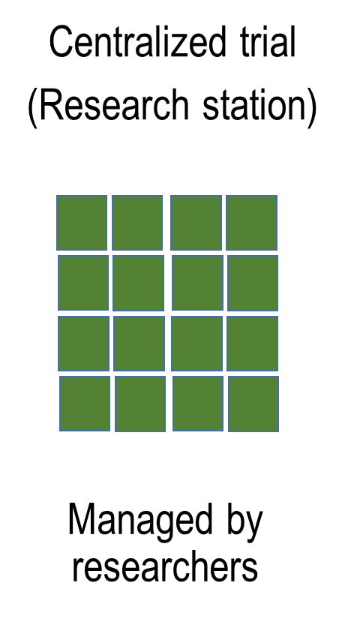
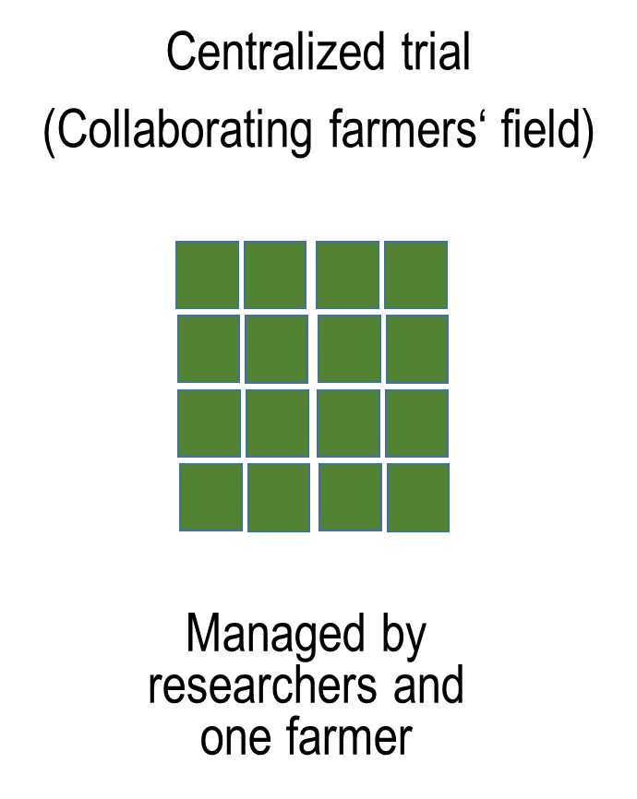
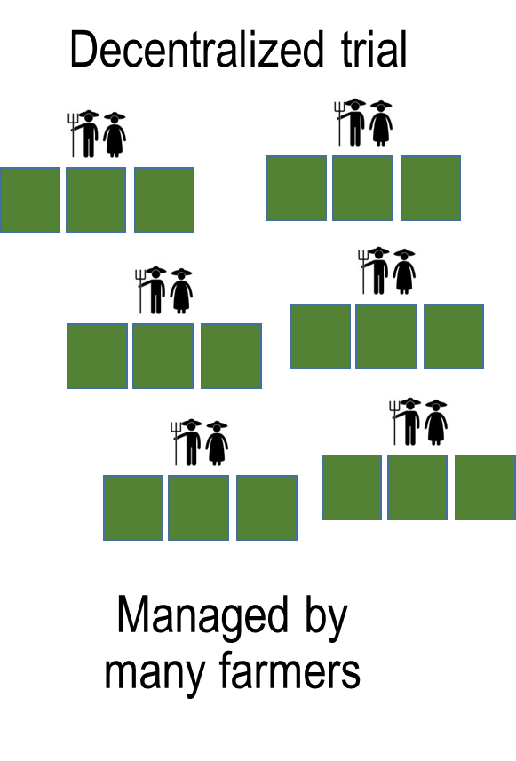
A new agricultural research paradigm

Slide 7

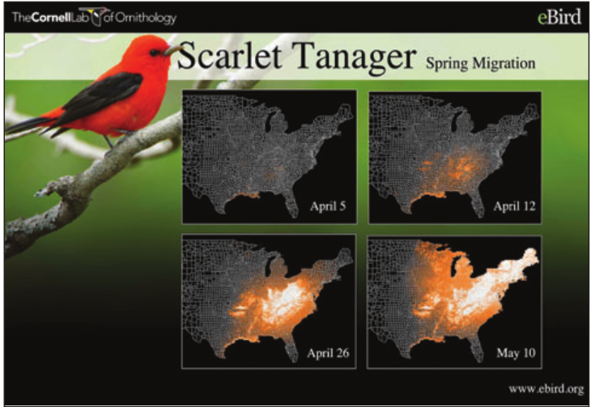

Citizen science Scientific research carried out, at least in part, by non-professional scientists
Dickinson et al. (2012) Front. Ecol. Environ. 10(6):291-297

Slide 8
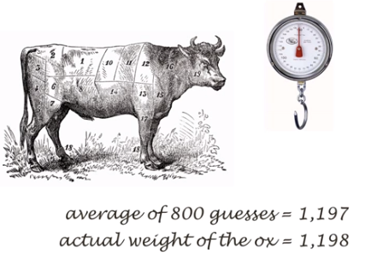
“Wisdom of Crowds”
In 1906, the English polymath Francis Galton visited a country fair in which 800 people took part in a contest to guess the weight of ox.
Surowiecki (2004) The wisdom of crowds.

Slide 9
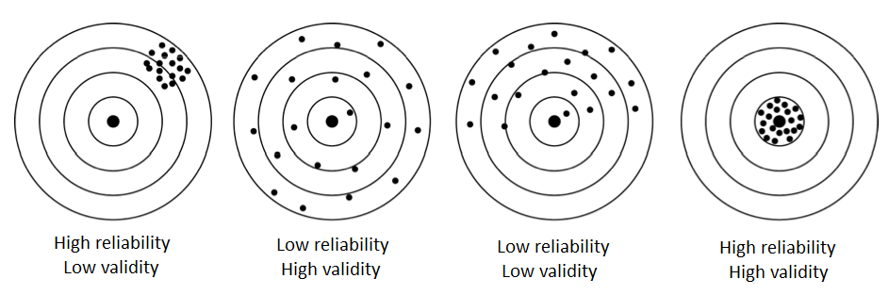
Data accuracy: Reliability vs validity
?
Notes:
Low reliability: You don‘t always hit the center.
But high reliability: By looking at the cloud of shots, we can still figure out where the center is.

Slide 10

Distributed variety trials instead of centralized experiments
van Etten et al. (2016) Expl. Agric.
Beza et al. (2017) PloS ONE 12(5):e0175700
Notes:
Using citizen science and the wisdom of crowds:
Split the big trial into many micro-trials
A methodology to aggregate the data from all farmers

Slide 11
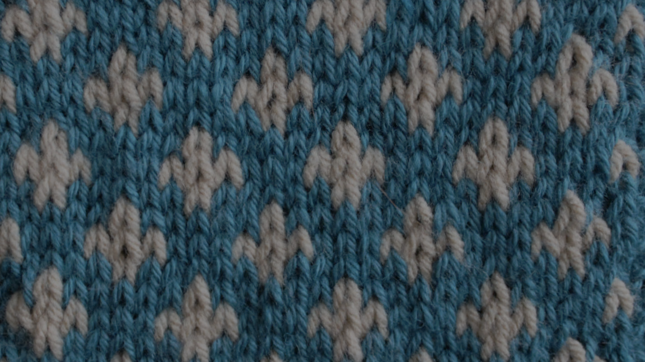
triadic comparisons of technologies tricot

Slide 12

Distributed variety trials instead of centralized experiments
Each farmer observes just 3 varieties
Farmers observe along the entire season
Under real farm conditions
Farmers rank the varieties, no need for exact measurements

Slide 13


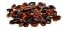


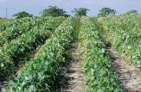
Each farmer receives 3 varieties from a larger pool of pre-selected varieties
A
B
Package #1
C

Slide 14
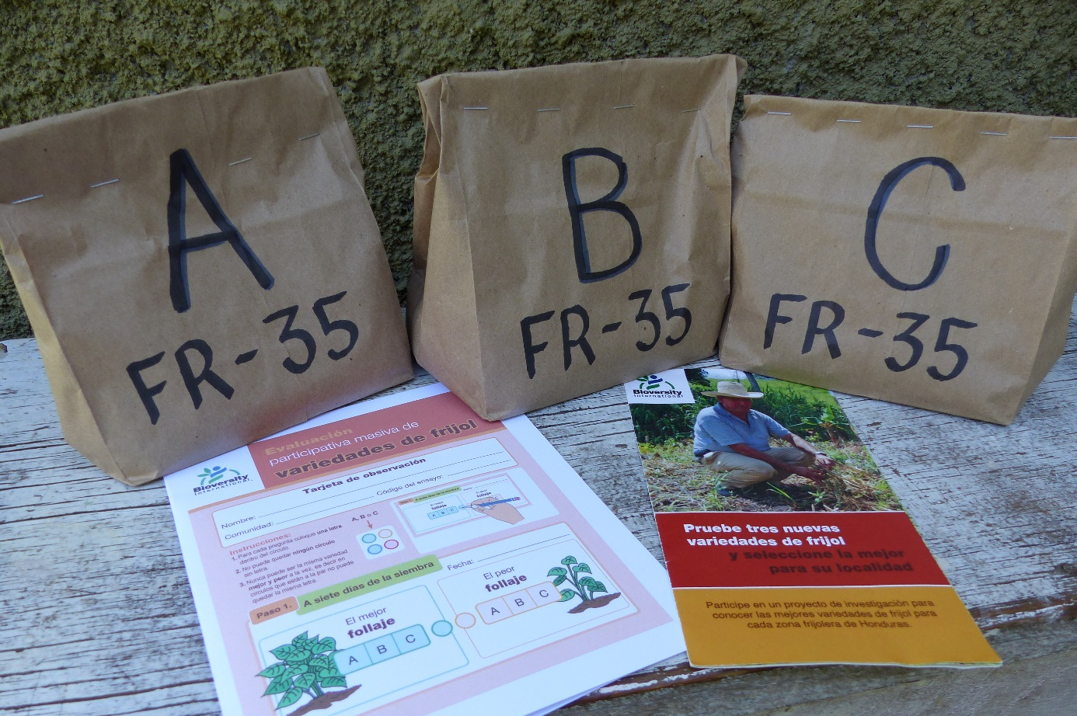
Each farmer receives a personal trial package
Small quantities of seed
3 different varieties
According to a randomization scheme
Observation card to record variety comparisons

Slide 15
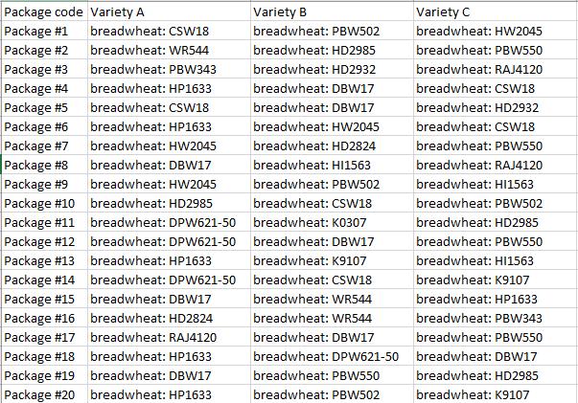
Variety randomization in tricot
Every farmer receives 3 out of 10 - 25 varieties
Farmer does not know the varieties names at first (just “A”,”B”,”C”)
Systematic randomization

Slide 16
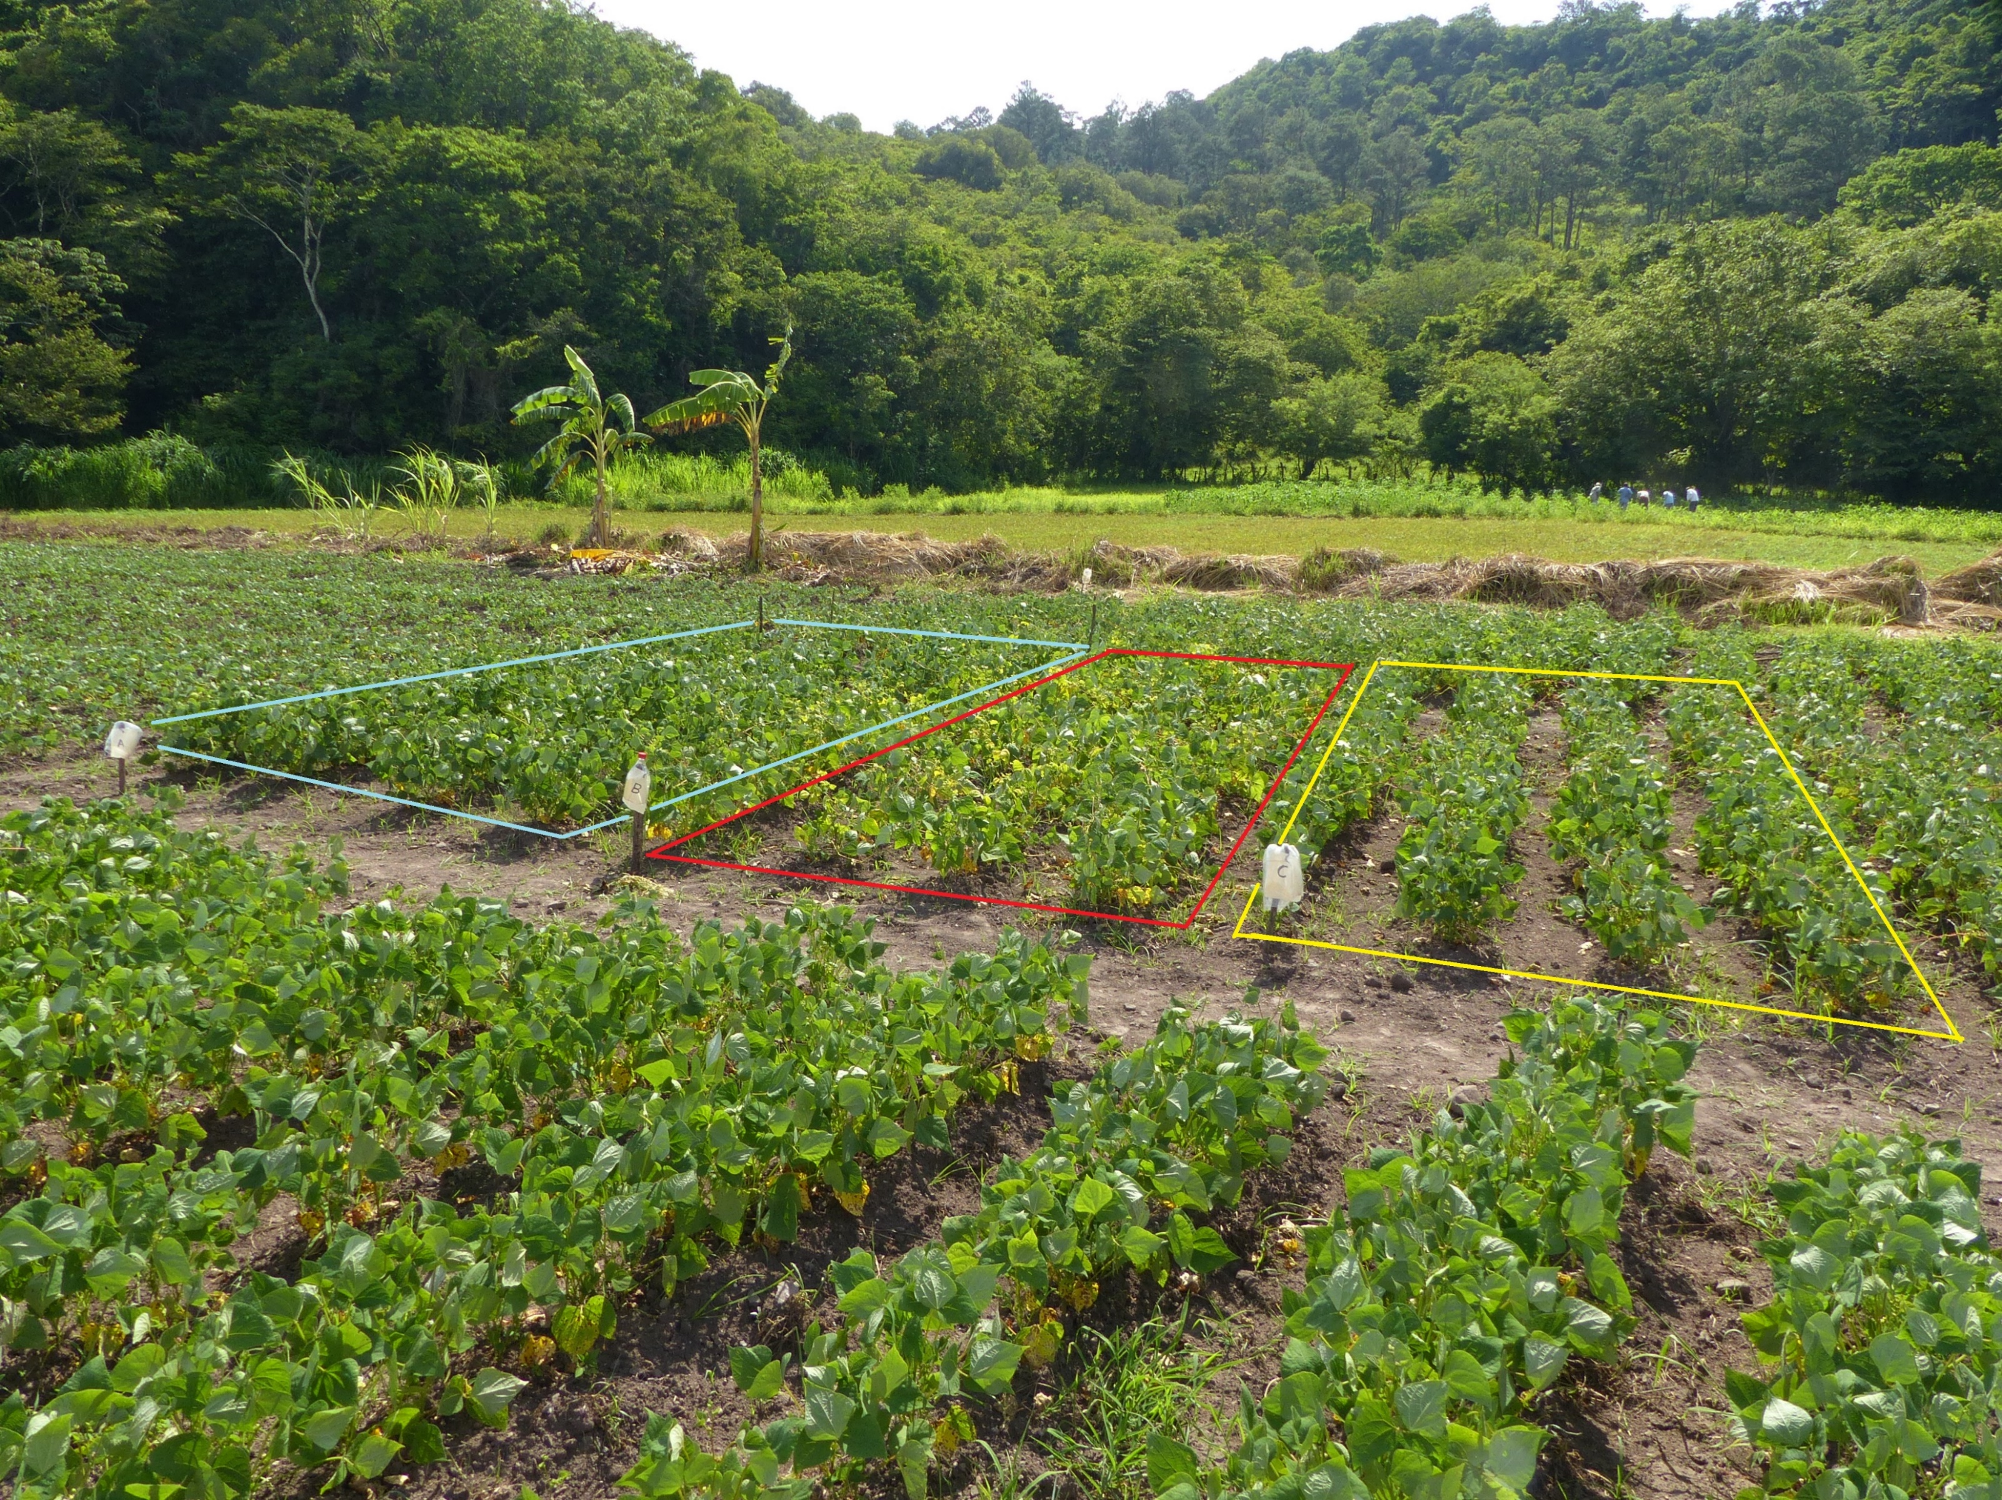
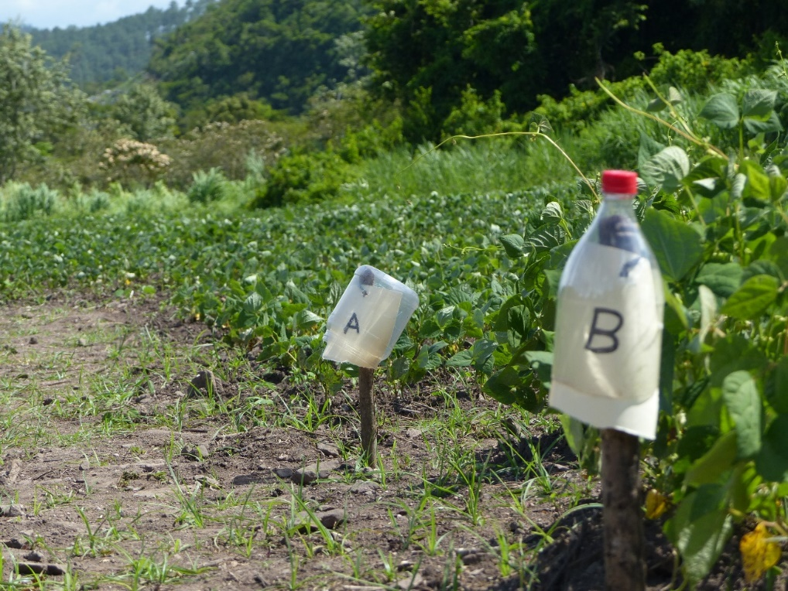
A tricot trial of common bean (Honduras)
A
B
C
Bean production plot (local variety)

Slide 17
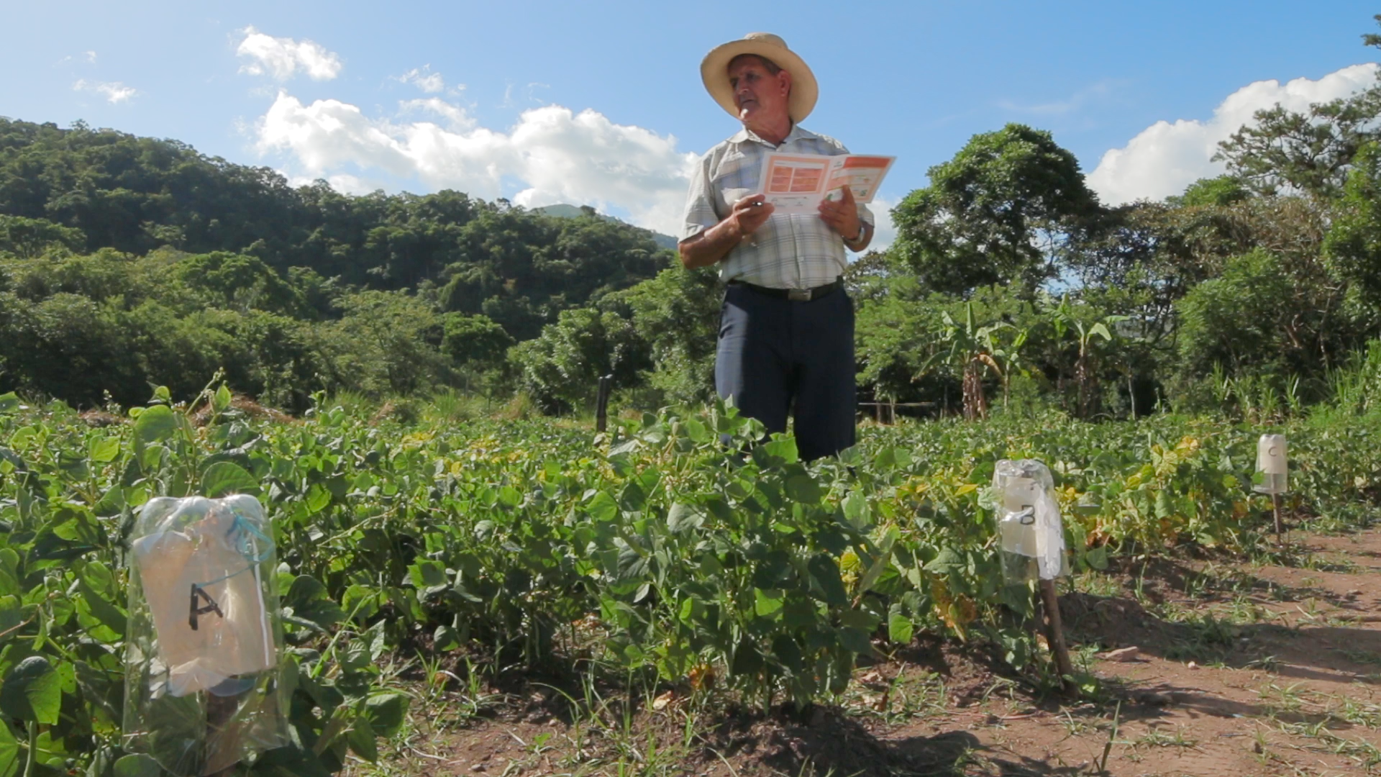
Farmers make simple observations in different criteria

Slide 18

Farmers make simple observations in different criteria

Slide 19
Farmers make simple observations in different criteria
Package number: ____________
Step #1
After 30 Days
Date: ____________
Best leaf development
Worst leaf development
Best in winding
Worst in winding
Notes:
Specific, observable criteria
That are relevant to the farmers
We always ask for the best and the worst
Two questions only: Very simple for the farmers
When you have more than three varieties, it gets more complicated

Slide 20
Farmers make simple observations in different criteria
FR-35
Package number: ____________
Step #1
After 30 Days
10 November 2018
Date: ____________
Best leaf development
Worst leaf development
C
A
Best in winding
Worst in winding
B
C
Notes:
Specific, observable criteria
That are relevant to the farmers
We always ask for the best and the worst
Two questions only: Very simple for the farmers
When you have more than three varieties, it gets more complicated

Slide 21
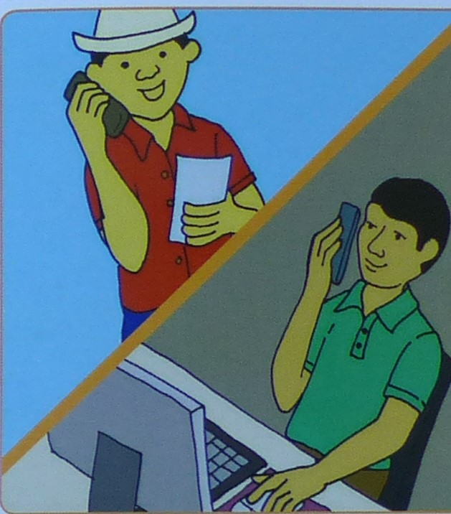
Project managers collect data from farmers, for analysis
Phone calls
ODK app
Type card information

Slide 22

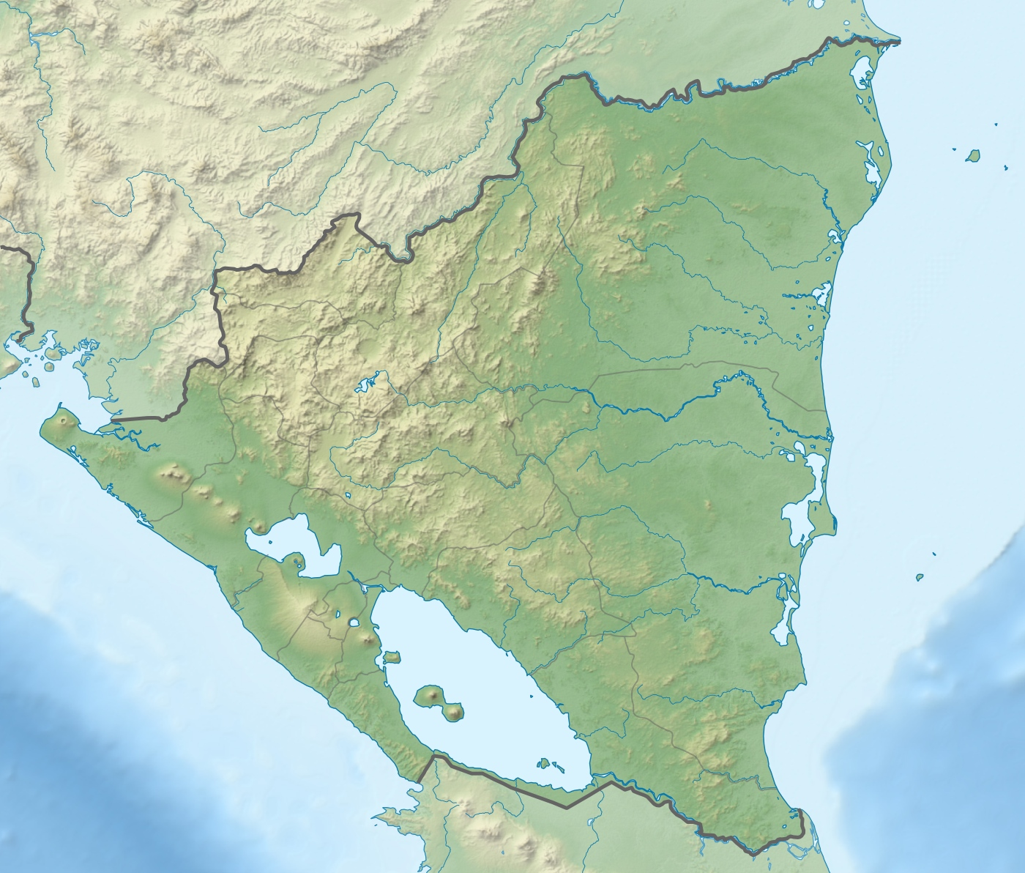

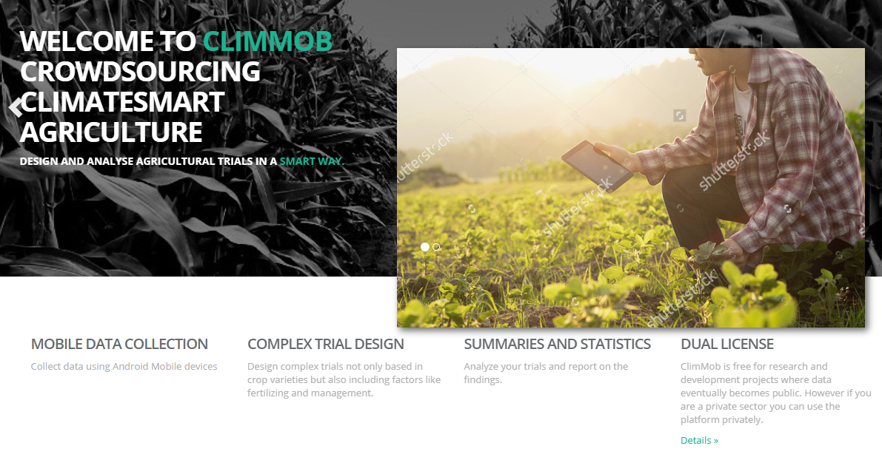

Slide 23
Combining many partial rankings to the full picture
+ -
A > C > D
C > D > G
A > D > G
A>C>D>G
Turner et al. (2019) CRAN PlackettLuce

Slide 24
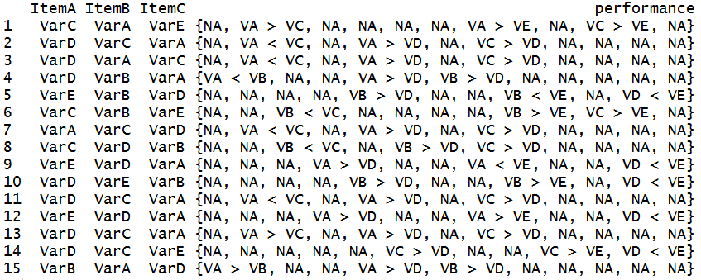
Model with partial rankings
Turner et al. (2019) CRAN PlackettLuce

Slide 25
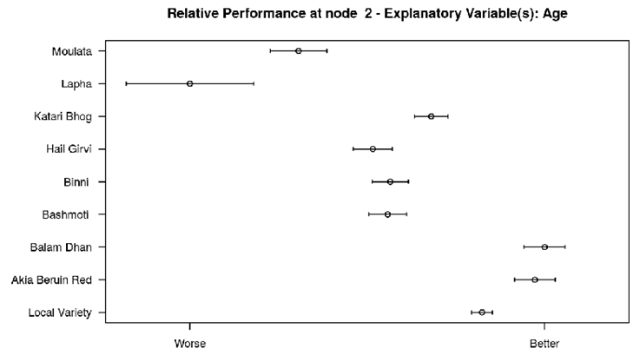
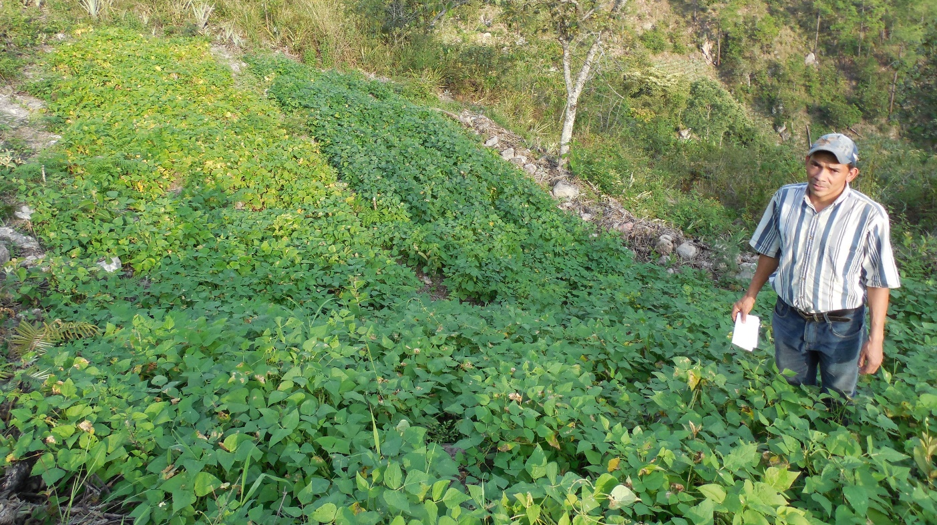
Two levels of learning
Local learning – Farmers use comparative approach and heuristic learning to identify suitable solutions
Global learning – Researchers aggregate results and infer patterns, make decisions about which varieties work where
Notes:
Tricot is a research methodology, but also a tool for diversity dissemination
In some cases, it is not even used for research, juts to introduce diversity to farms

Slide 26
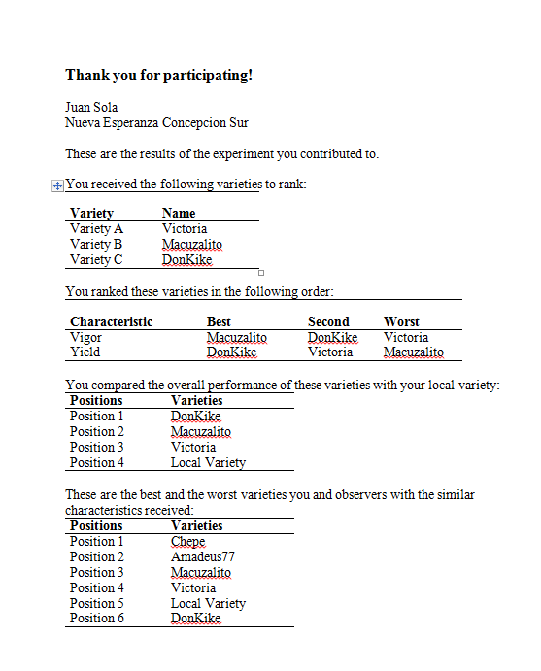
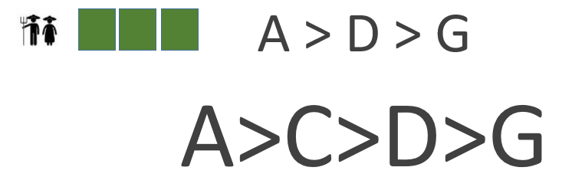
Local learning
Farmers learn names of the 3 varieties
Full variety ranking according to all farmers

Slide 27
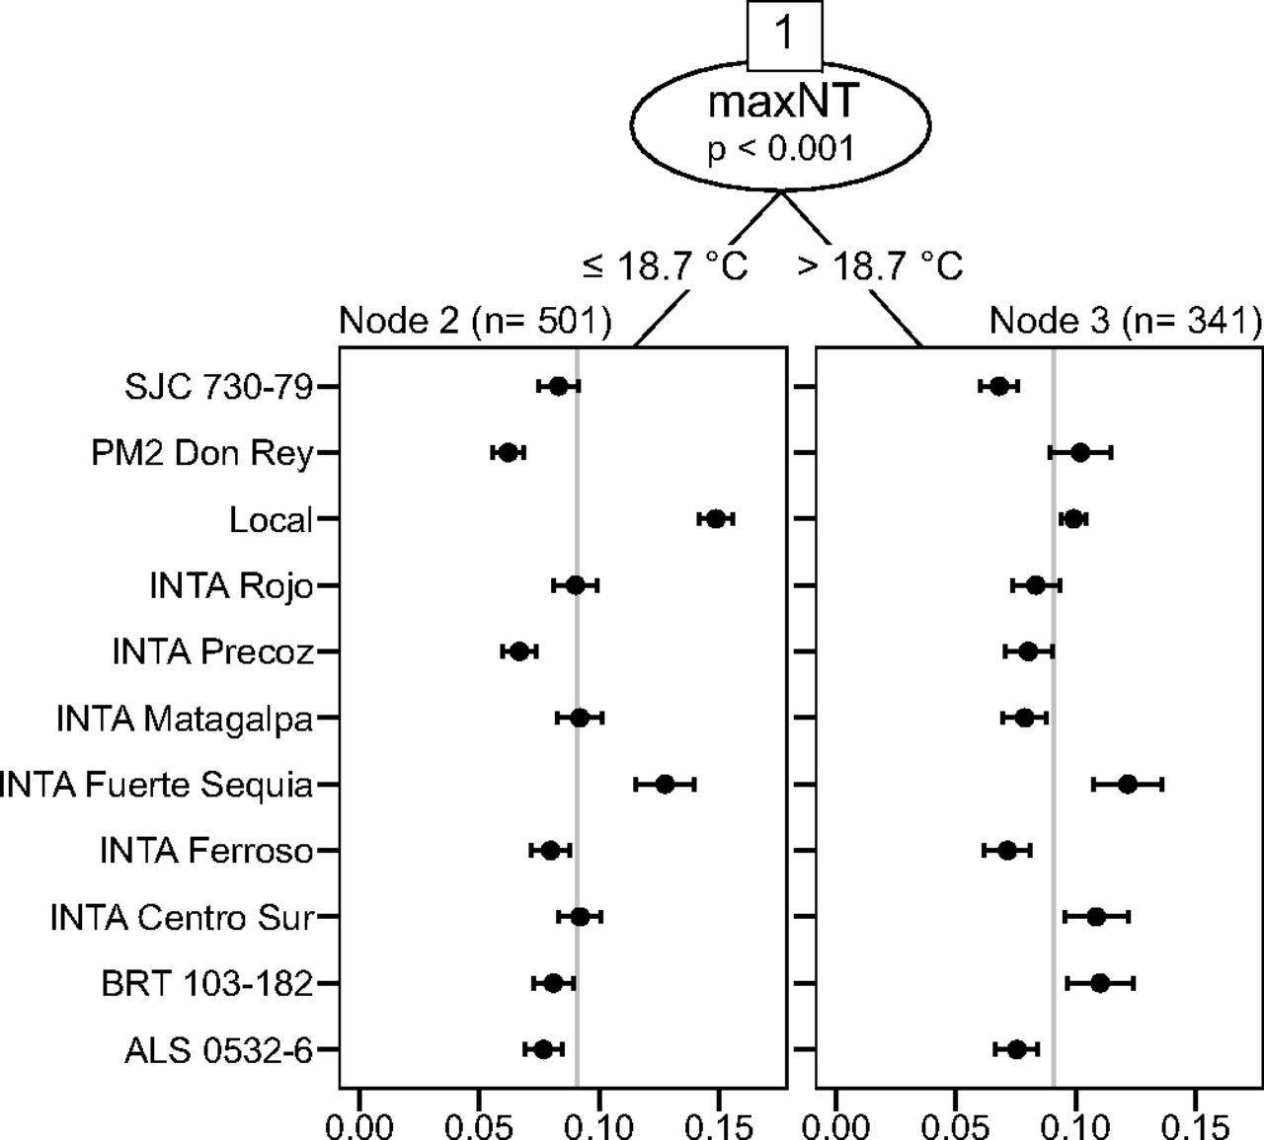
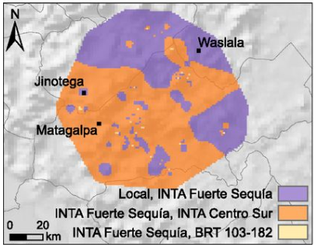
Global learning
van Etten et al. (2019) PNAS 116(10):4194-4199

Slide 28
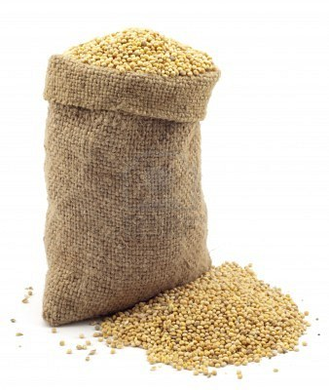
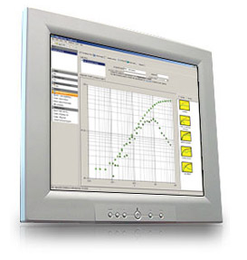
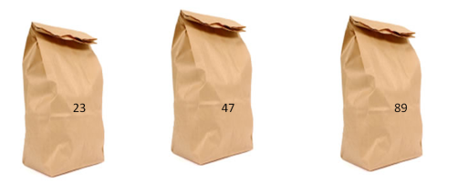


The cycle of tricot research
1. A broad set of varieties (10-25) is evaluated
5. Data are used to evaluate varieties and to detect demand for new varieties and traits
A > C > D
C > D > G
A > D > G
A>C>D>G
6. Farmers receive variety recommendations and can order seeds
2. Each farmer gets a combination of 3 varieties
3. Farmer plants a trial and makes observations
4. Project managers collect farmers’ observations
van Etten et al. (2016) Expl. Agric.
Beza et al. (2017) PloS ONE 12(5):e0175700
Notes:
The ultimate aim is that the whole seed system becomes more responsive. Information goes around to keep constantly adapting to change, matching seeds to emerging needs.

Slide 29
In summary
Simple setup – little farmer training needed
Research / project staff does not need to supervise or visit trials
Results collected remotely through telephone calls
Trials under real farming circumstances
Observation along the entire cropping cycle
Accurate results thanks to “Wisdom of Crowds”
Farmers may quickly identify varieties that fit the conditions at their farm

Slide 30

Thank you!

Slide 31
This is a compilation of several presentations of the members of Bioversity International’s “Information Services and Seed Supplies” Team. If you need to cite it, we suggest the following:
Steinke, J.; Gupta, A.; van Etten, J.; de Sousa, K. (2019) The “tricot” crowdsourcing methodology for varietal diversification.
Other materials used in this training course are available at:
https://github.com/kauedesousa/ClimMobTools

